Slide 1
ESE562 Project 2
Po Hsu Chen, 448031

Slide 2
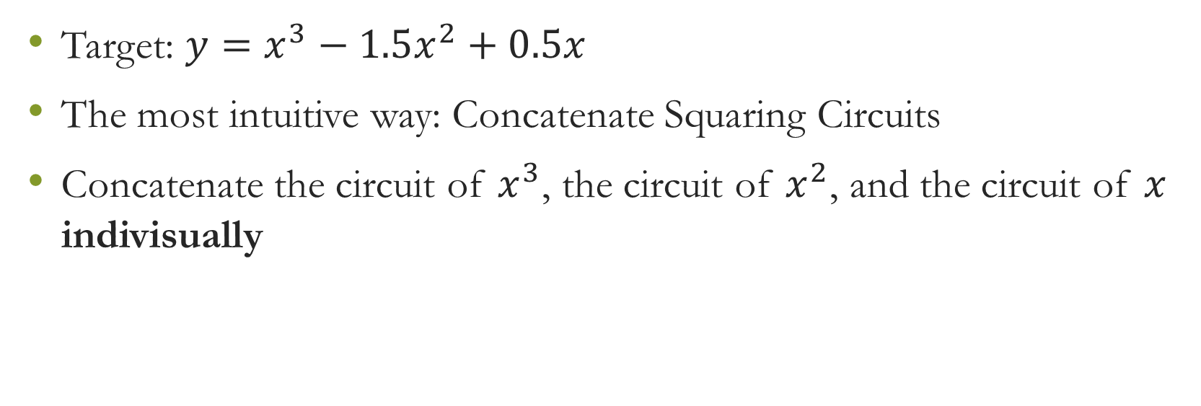
Intro
Target: ${y=x}^{3}−1.5x^{2}+0.5x$
The most intuitive way: Concatenate Squaring Circuits
Concatenate the circuit of $x^{3}$, the circuit of $x^{2}$, and the circuit of $x$ indivisually
Notes:
When we see a func, we want to implement it. I use reduction! We can regard this into x tubed, minus 1.5 x squared, plus 0.5x

Slide 3
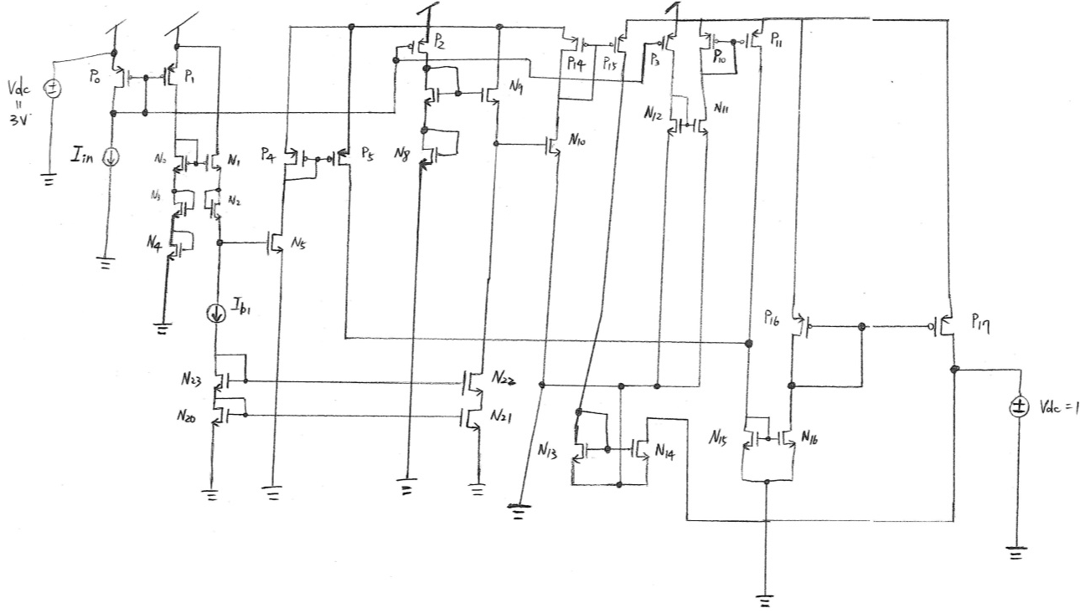
Circuit Schematic

Slide 4
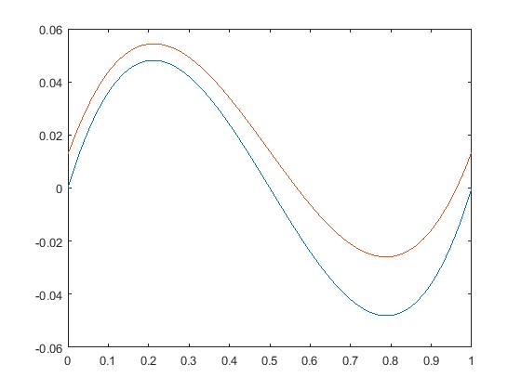
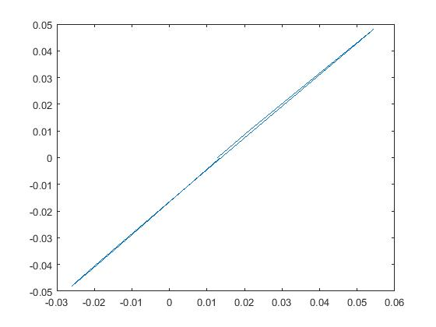
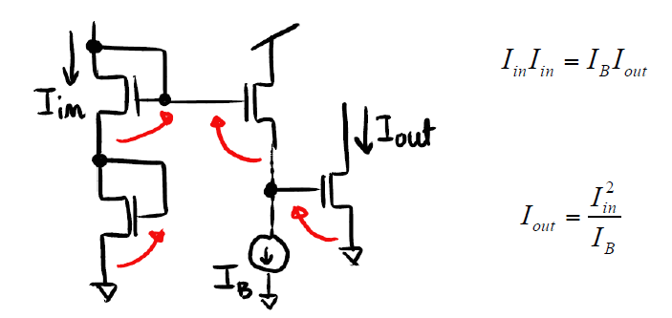
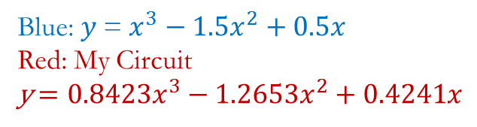
Results
Blue: $y$= $x^{3}−1.5x^{2}+0.5x$
Red: My Circuit
y$=0.8423x^{3}−1.2653x^{2}+0.4241x$
Why differ?
Since the current that produced by current mirror will not exactly equal to the input. Plus, it’s not always be constant as well.
When we stack more than 3 MOSFET => the kappa effects accumulated (appears)
How to improve the design?
Notes:
How improve?

